Slide 1
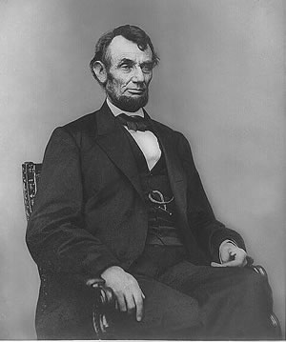
Abraham Lincoln

Slide 2
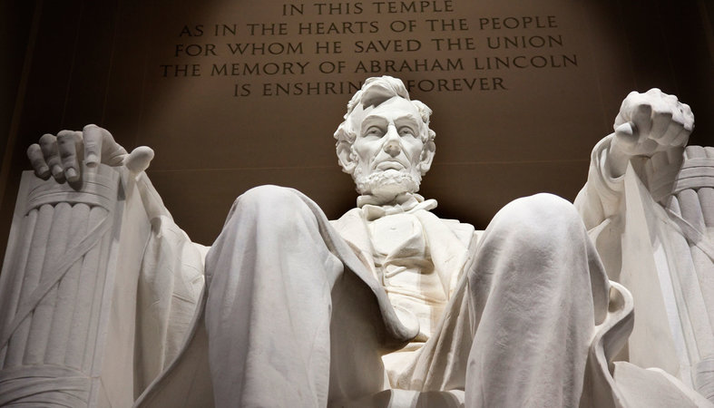

Slide 3
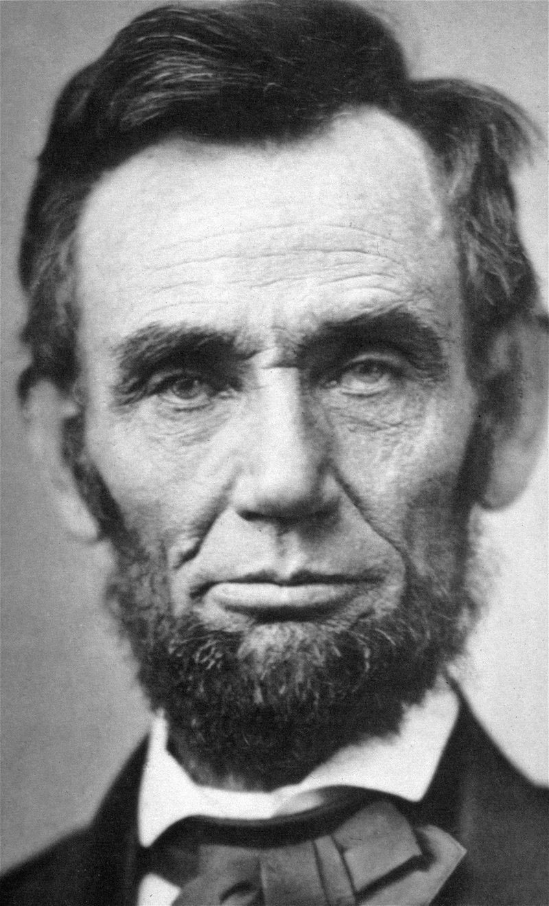

Slide 4
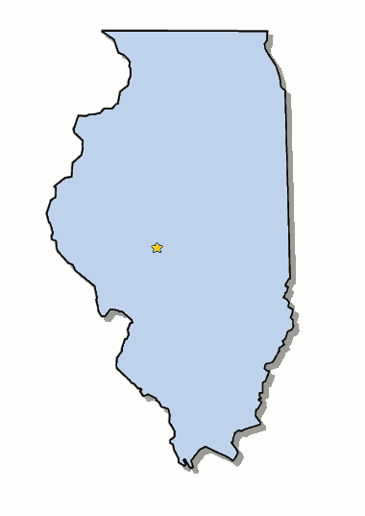
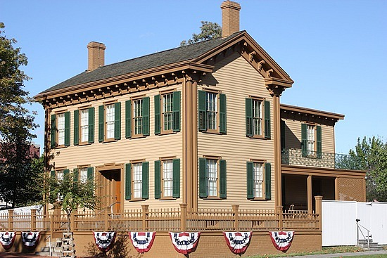
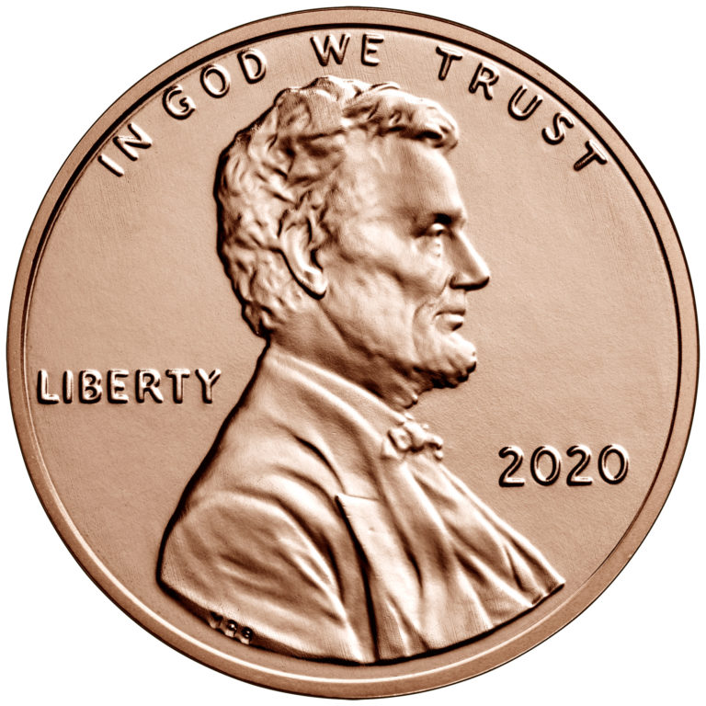
Elected in: 1860, 1864
President from: 1861-1865
Political Party: Republican
Home State: Illinois

Slide 5
New States
35) West Virginia
36) Nevada

Slide 6
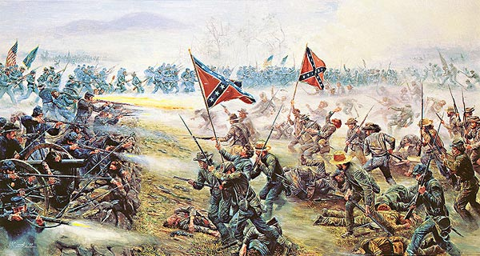
The Civil War
1861-1865

Slide 7
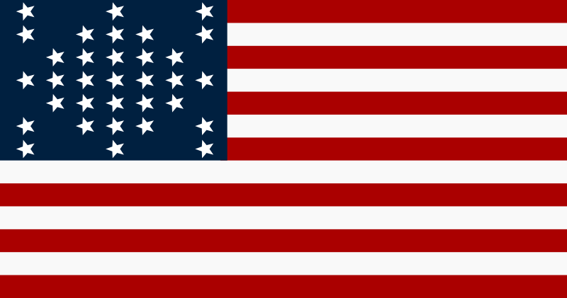
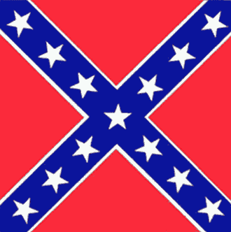
Who is who?
North South
Name: United States Confederate States
Leader: Abraham Lincoln Jefferson Davis
Capital: Washington DC Montgomery AL, Richmond VA
Uniforms: Blue Gray (official)
AKA: The Union Dixie
Nickname: Yankees Rebels

Slide 8
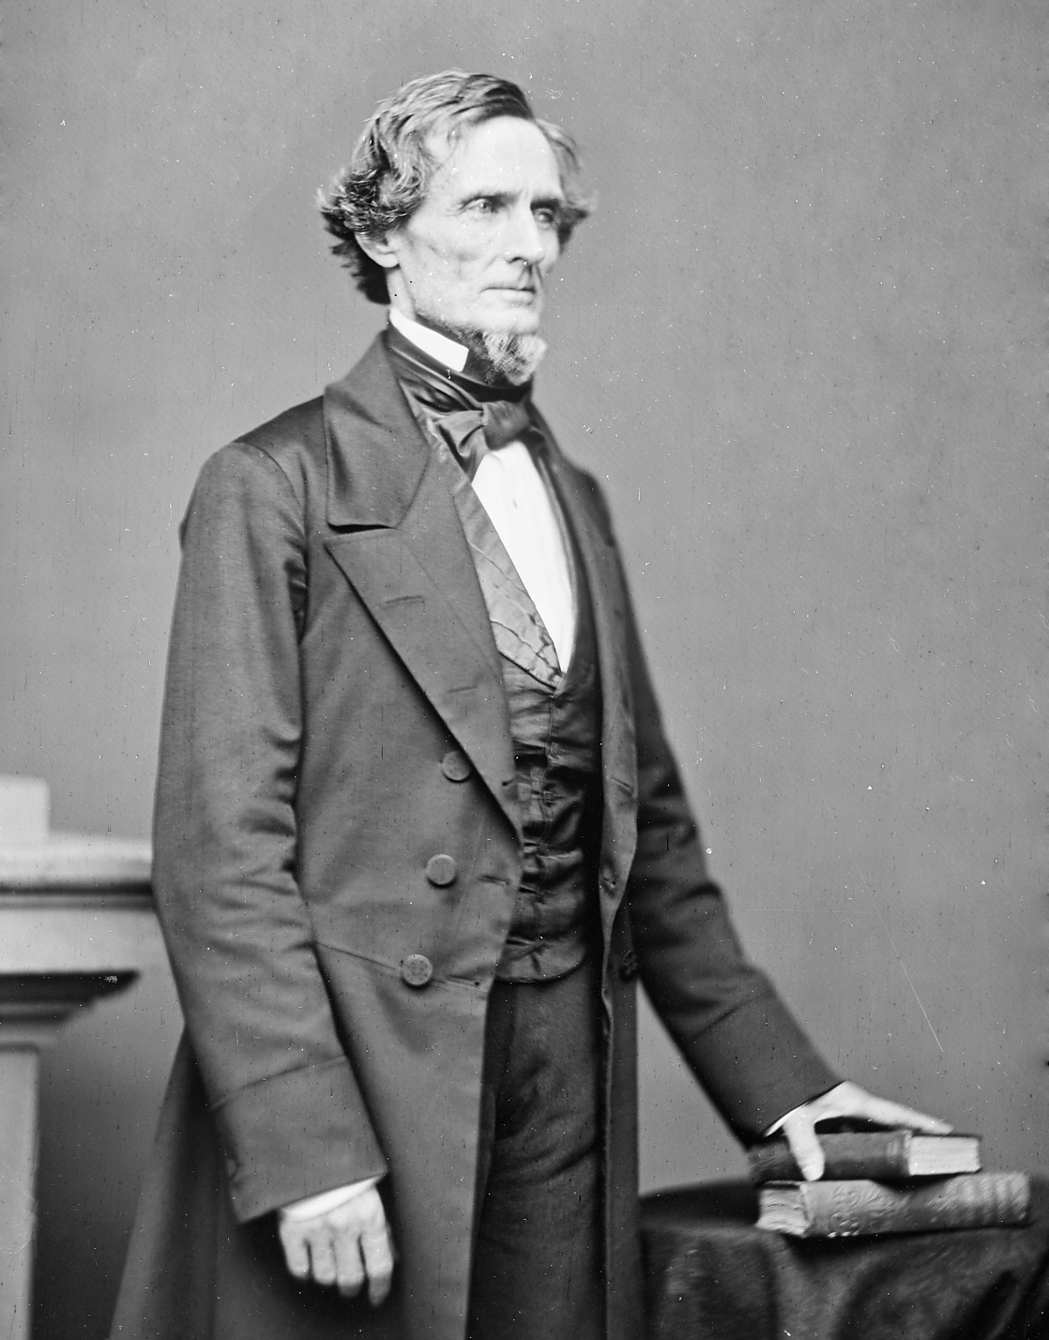
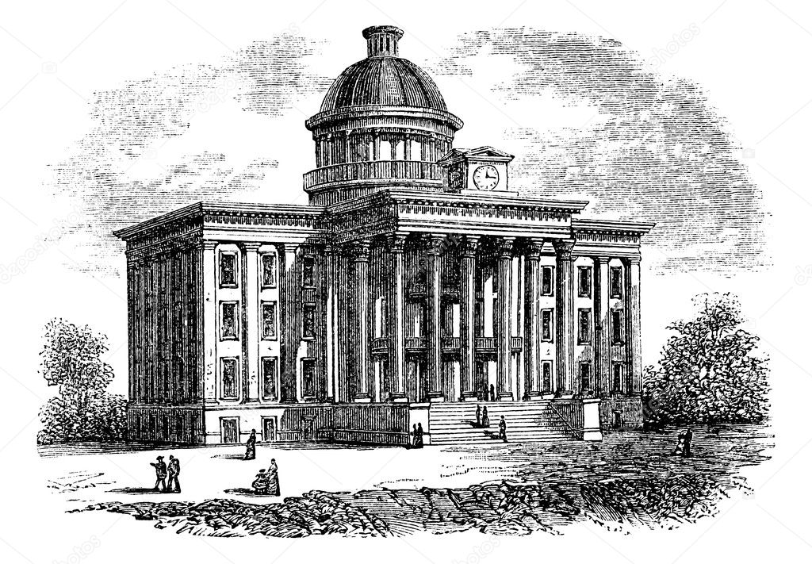
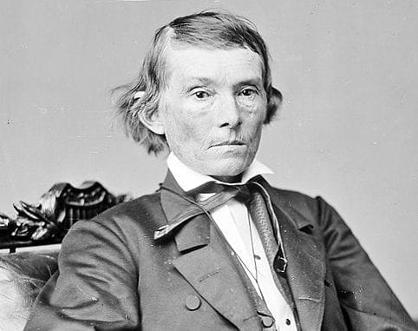
Confederate President: Jefferson Davis
Vice President Alexander Stephens

Slide 9
Advantages & Disadvantages
North Advantages
Factories (86% Manufacturing, 92% workers)
Farmland (Similar acreage, but devoted to food)
Railroads (71% of all mileage)
Population (22 million)
Established government
Larger Navy
4x the wealth of the South
South Advantages
Military schools & culture
Very strong morale (at first)
Cotton for overseas trade
Defensive War
North Disadvantages
Not fighting for own territory
Significant Anti-war movement
Shortage of competent military officers
South Disadvantages
Smaller Population (9 million, including 3 million enslaved people)
Weak national government
Virtually no manufacturing

Slide 10
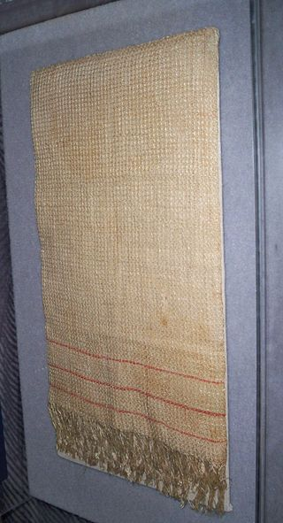
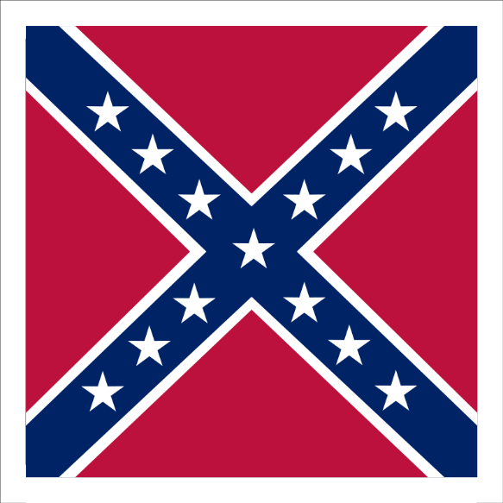
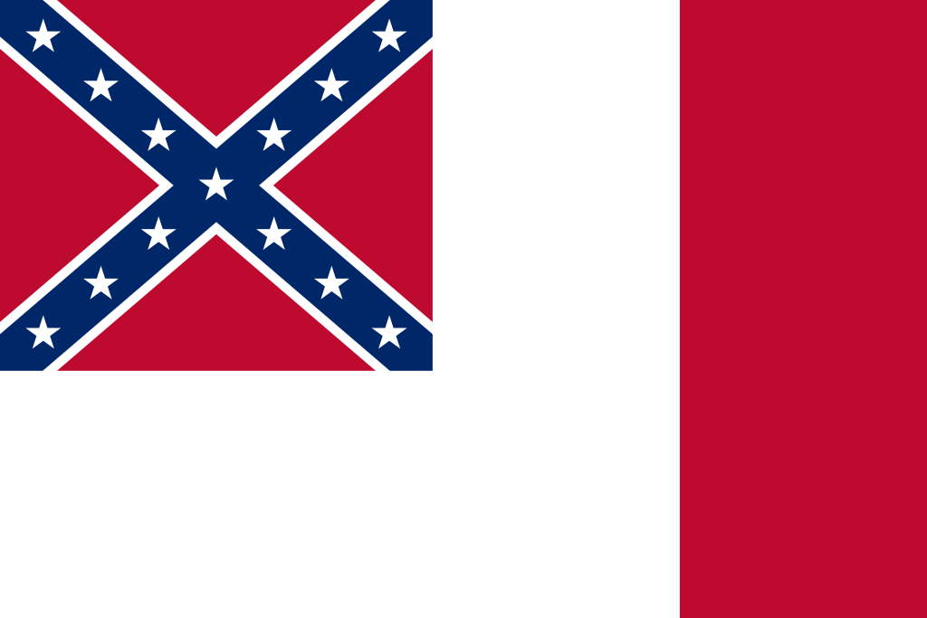
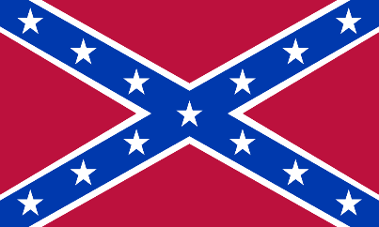
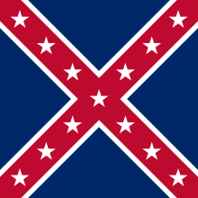
About that Confederate Flag…

Slide 11
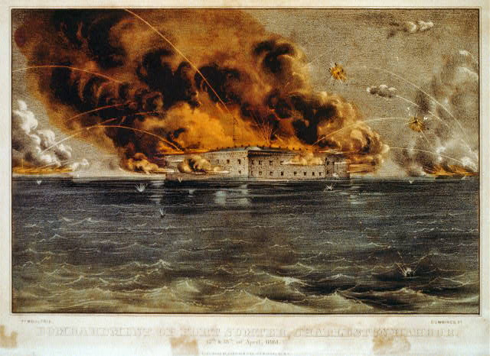
1861
April 12: The war begins when Confederates fire on Fort Sumter, SC

Slide 12
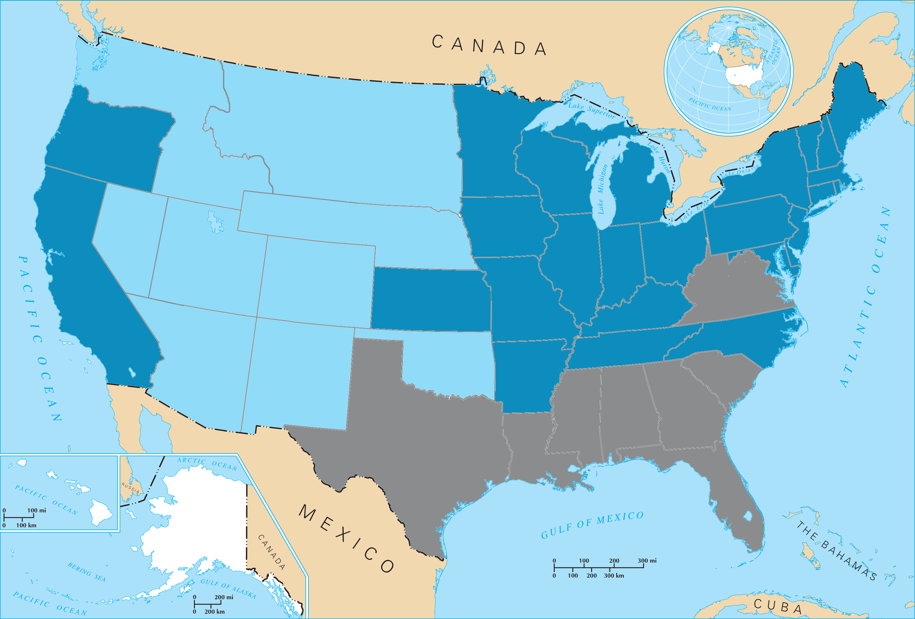
Virginia–April 23, 1861

Slide 13
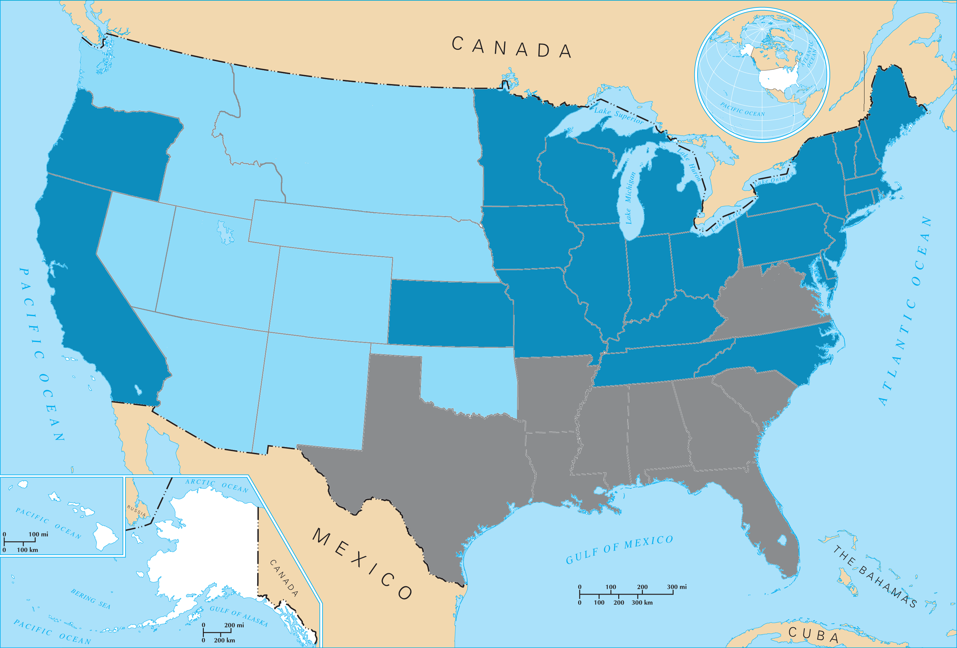
Arkansas–May 6, 1861

Slide 14
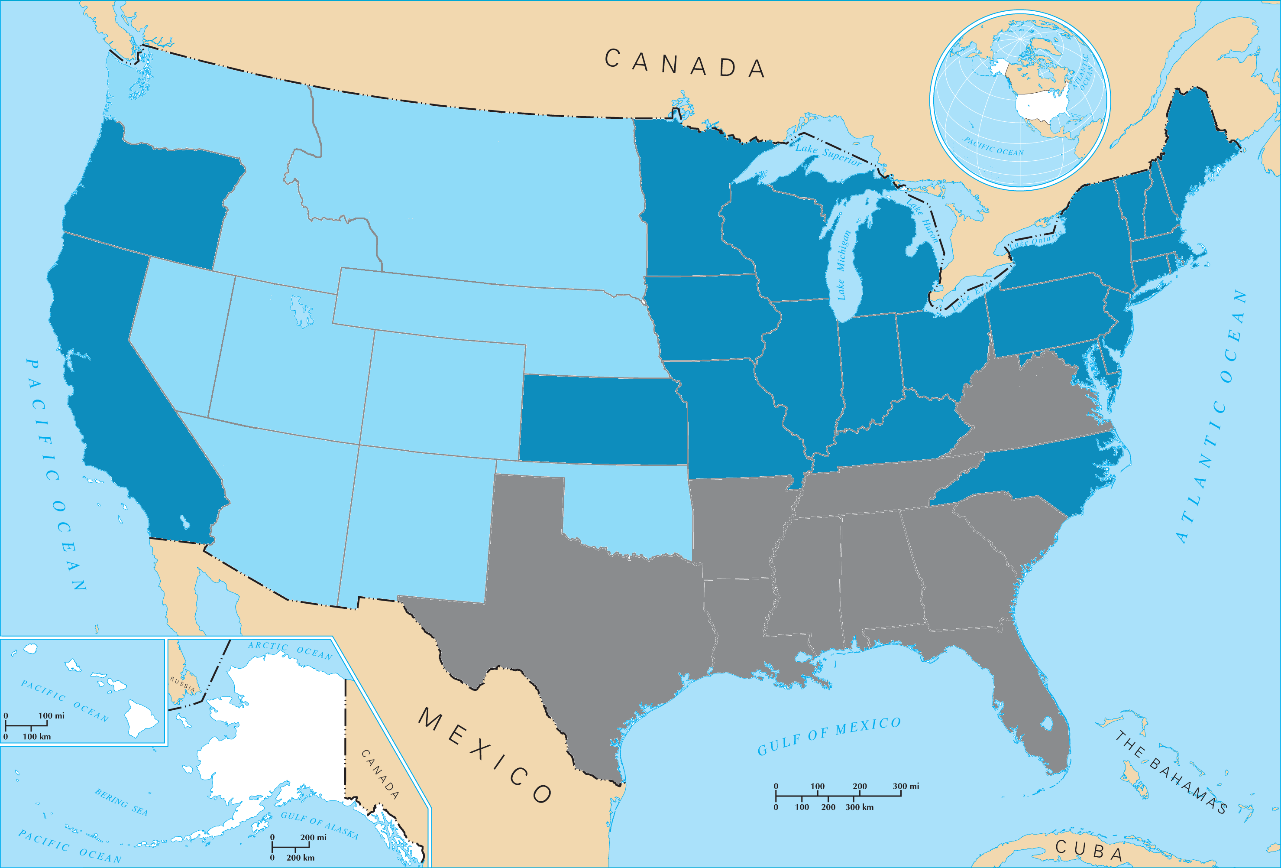
Tennessee–May 7, 1861

Slide 15
North Carolina–May 20, 1861

Slide 16
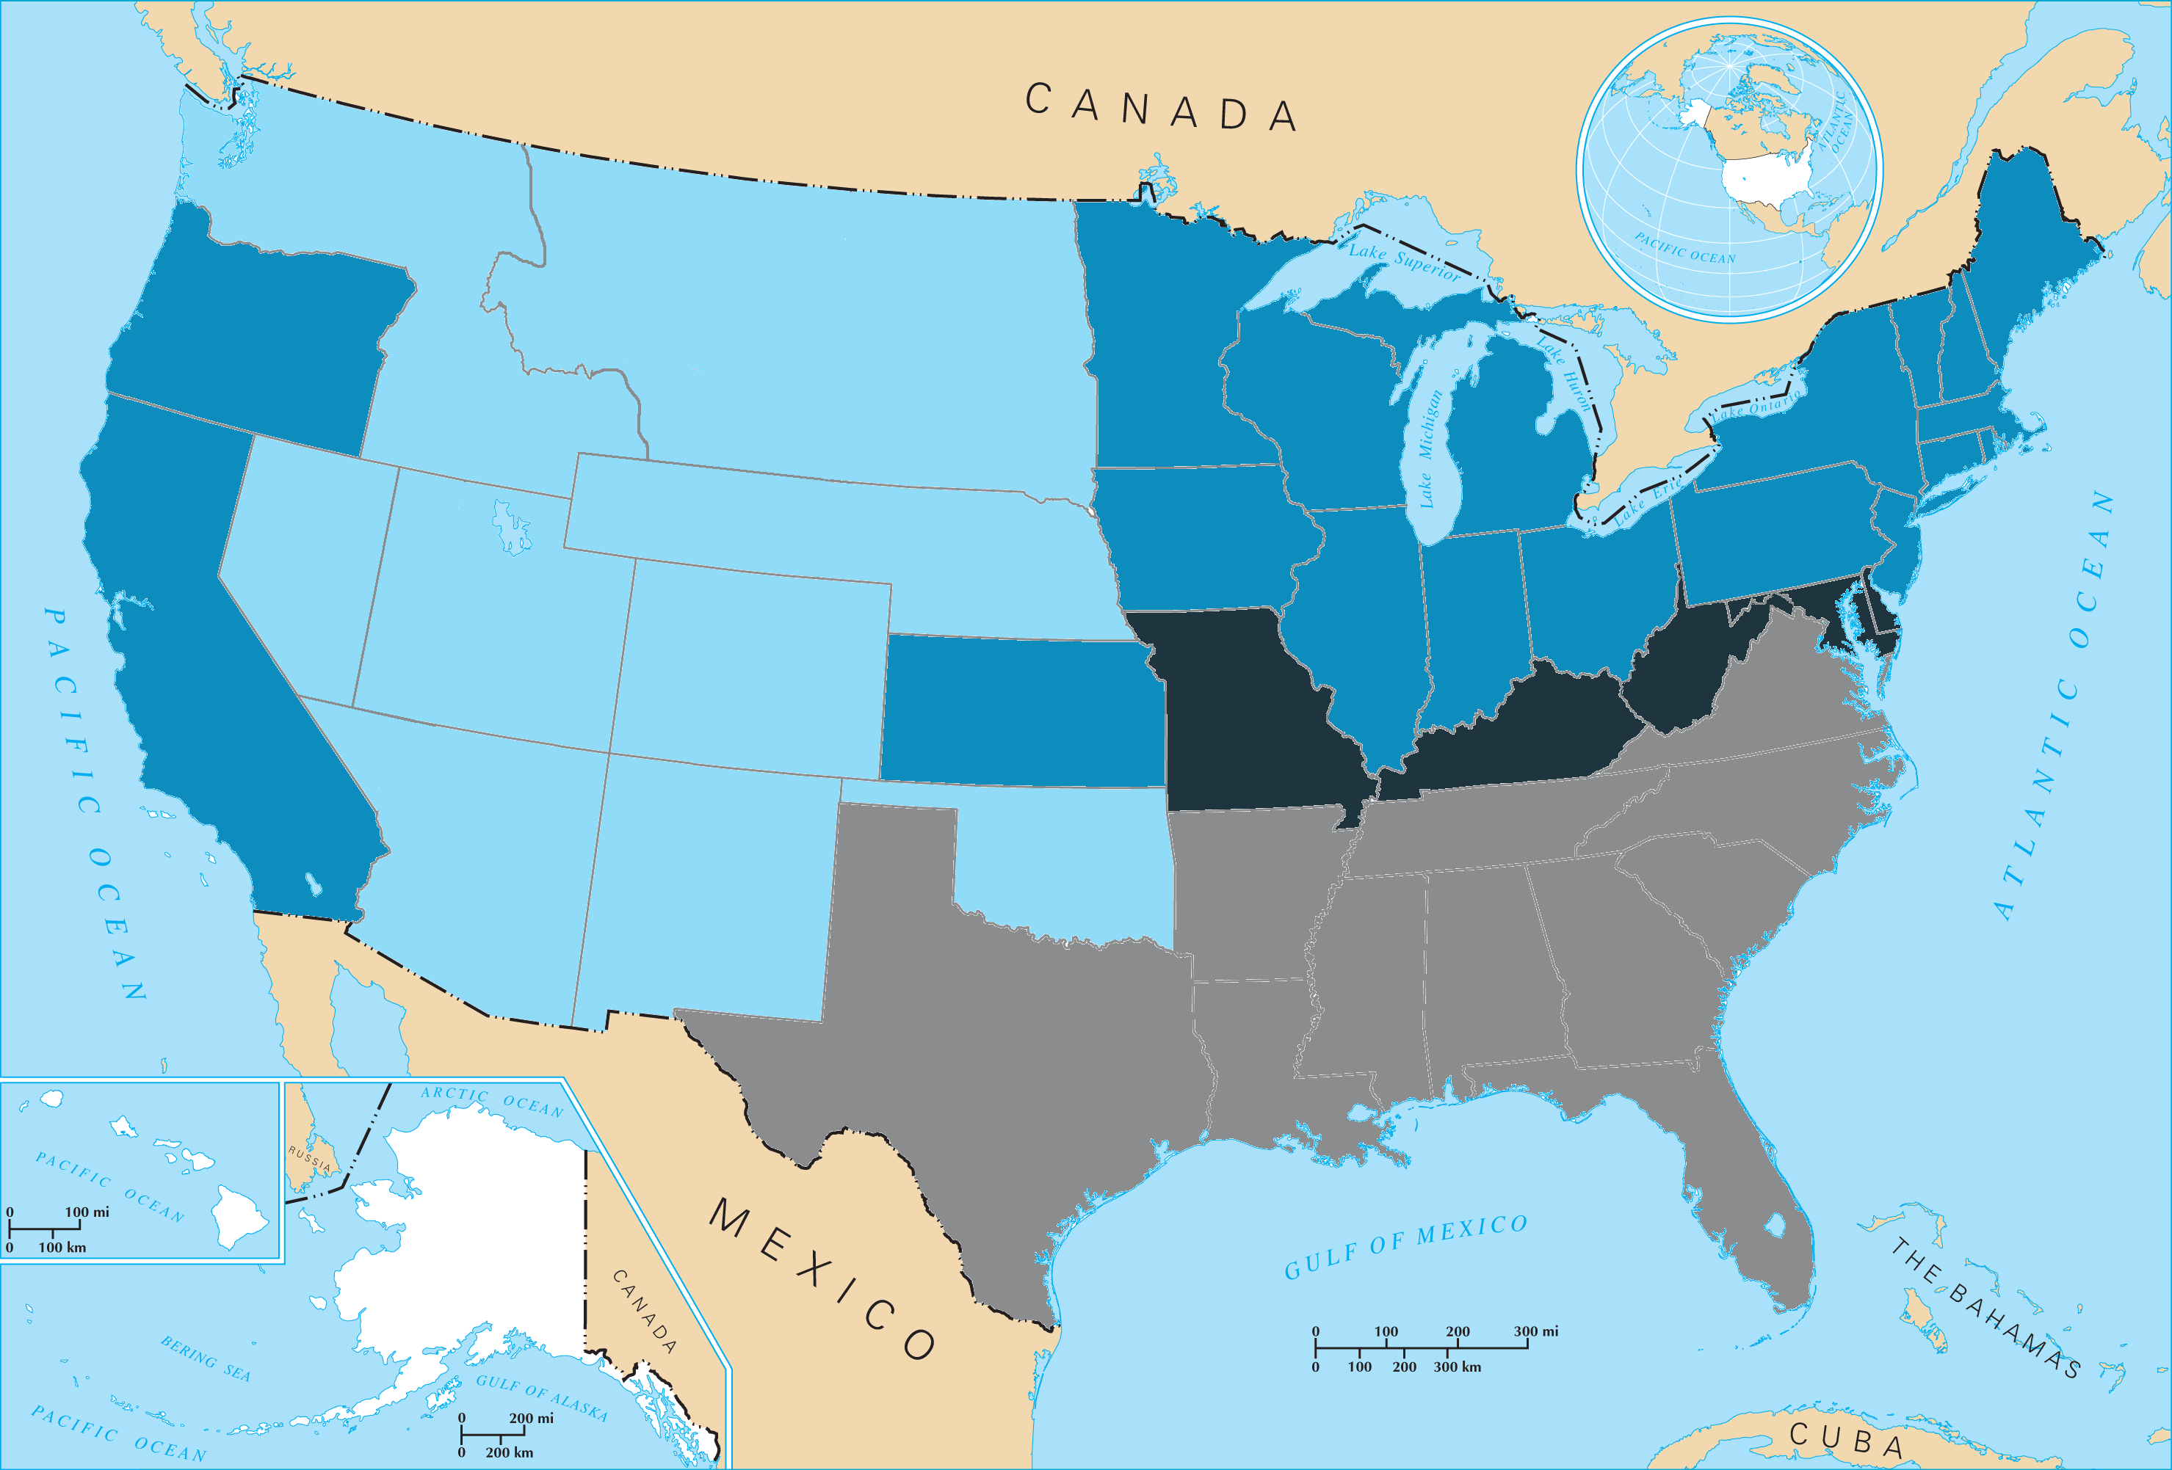
United States of America
Confederate States of America

Slide 17
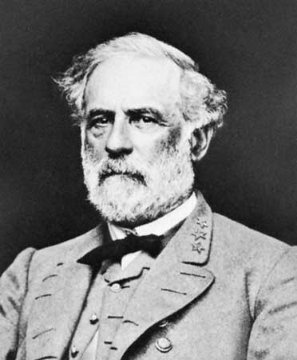
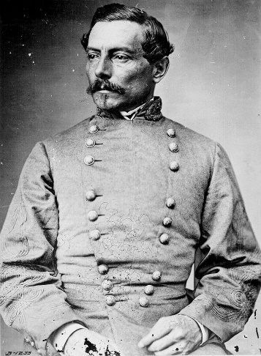
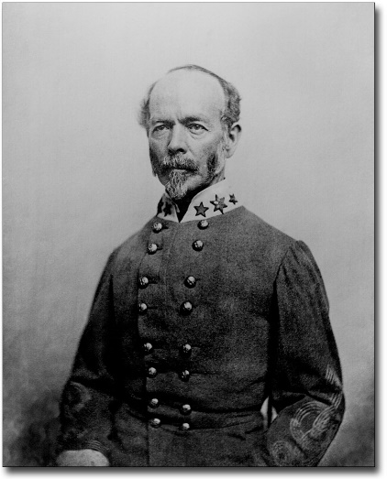
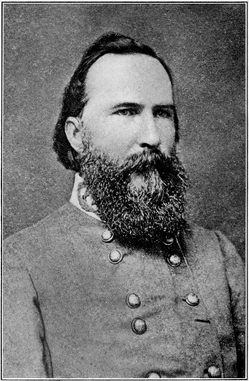
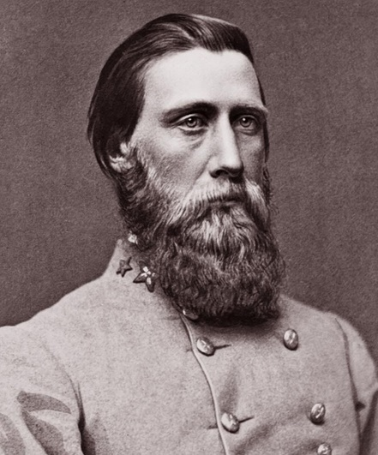
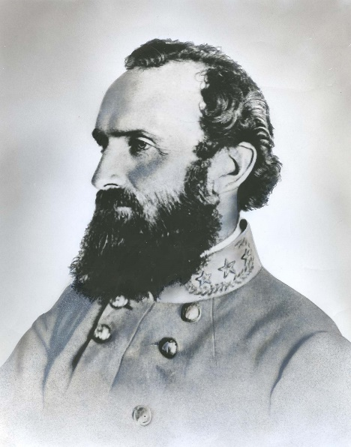
P.G.T. Beauregard
Joseph Johnston
Robert E. Lee
James Longstreet
John B. Hood
Thomas “Stonewall” Jackson

Slide 18
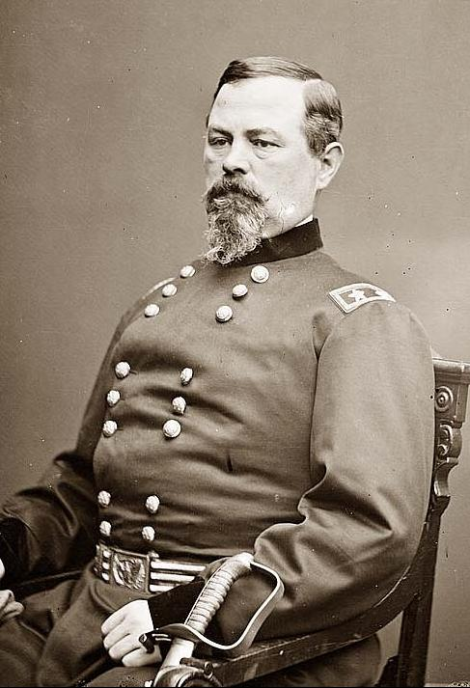
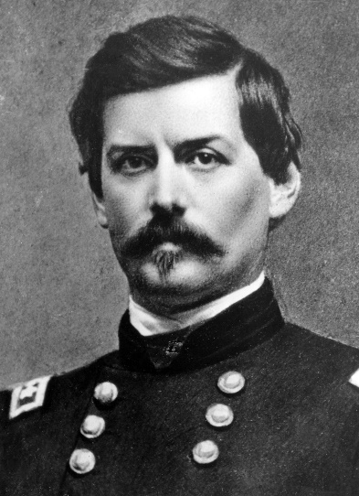
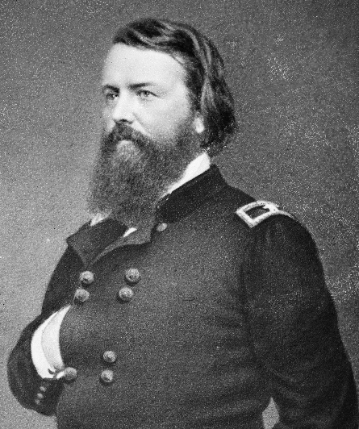
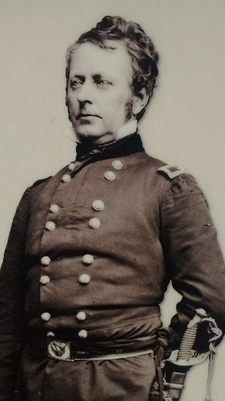
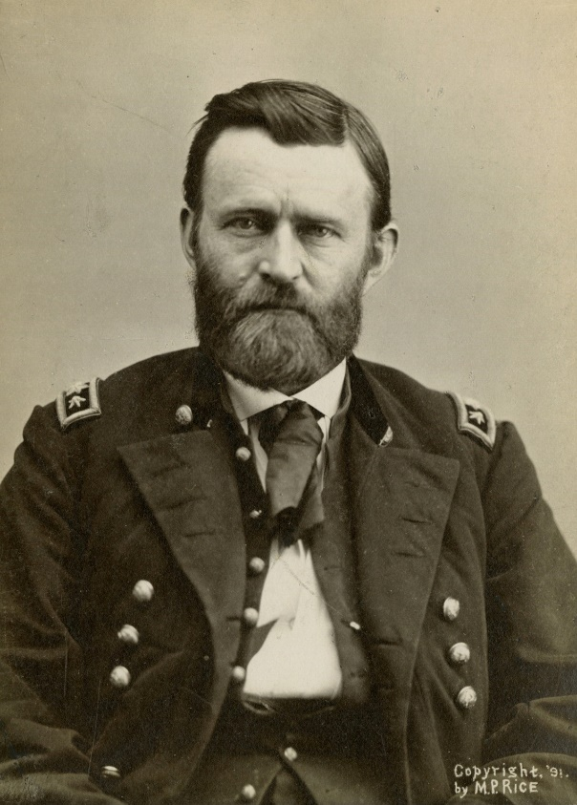
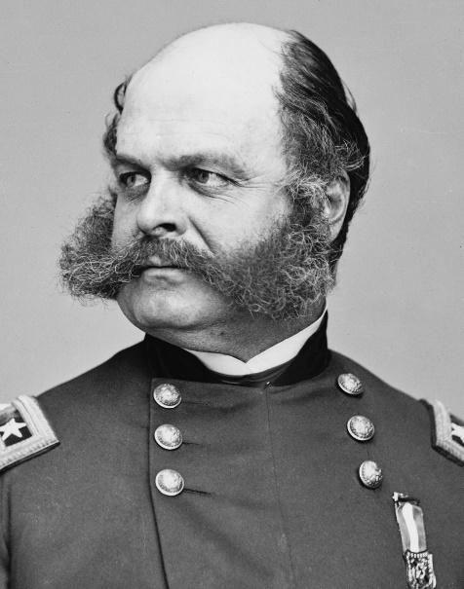
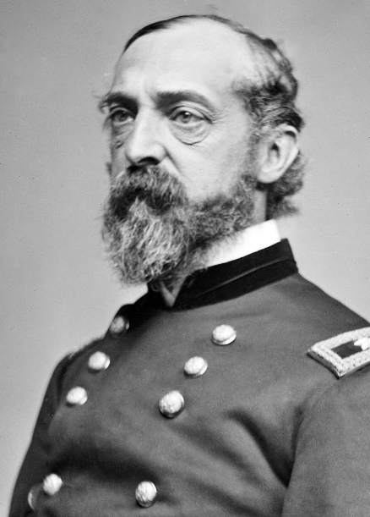
Irwin McDowell
George McClellan
John Pope
Joseph Hooker
Ambrose Burnside
George Meade
Ulysses S. Grant

Slide 19
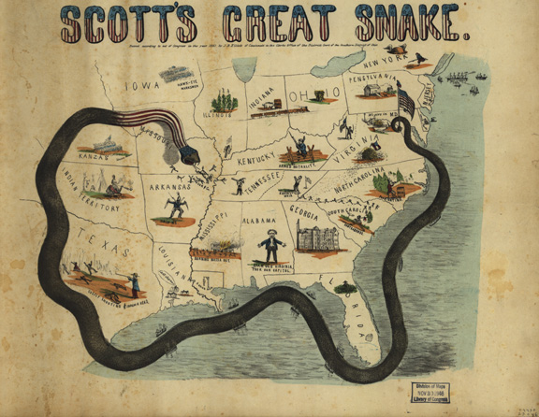
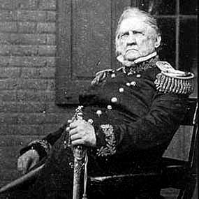
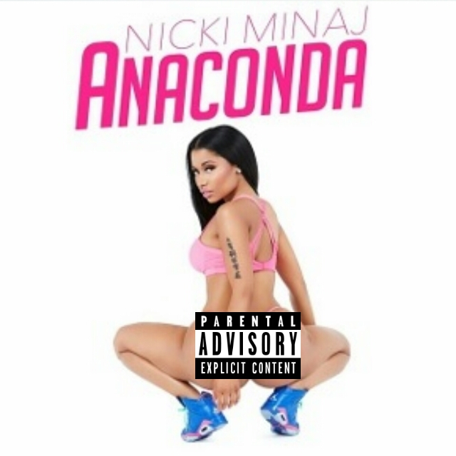
The Anaconda Plan

Slide 20
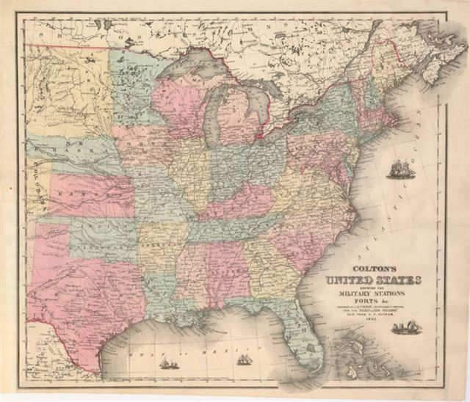
Union Plan:
Capture Richmond, VA
Capture the Mississippi River
Blockade the Southern coast
Attack through the heart of the South
Confederate Plan:
1. Keep the North out of the South.

Slide 21
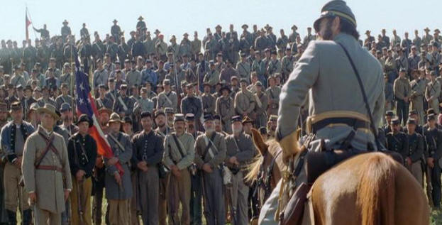
1861
Northern Plan:
In the East: Capture Richmond!

Slide 22
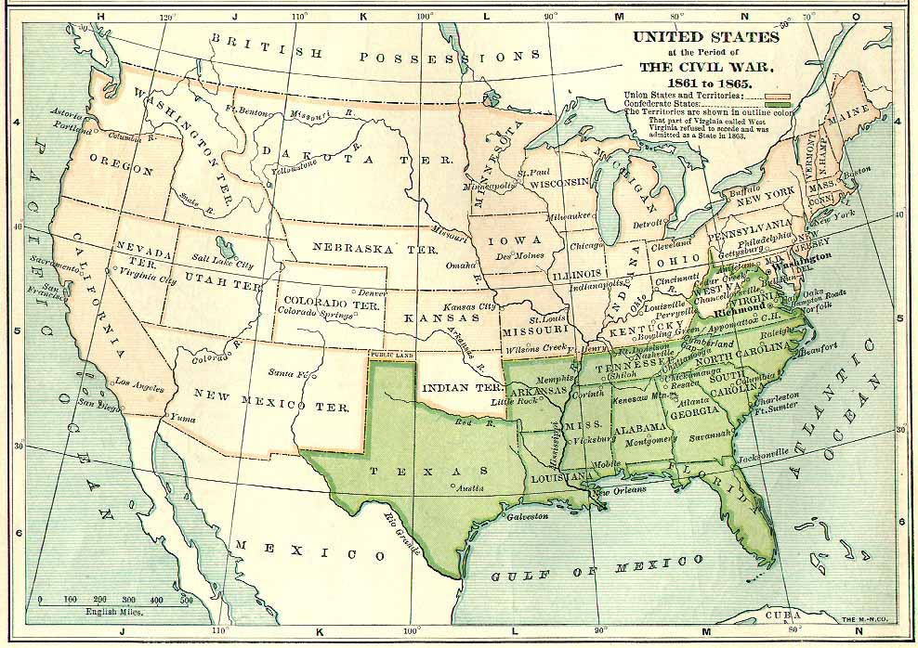
1861
The East:
Battle of Fort Sumter begins the war
-Confederates under Beauregard stop Union invasion of Virginia at Manassas

Slide 23
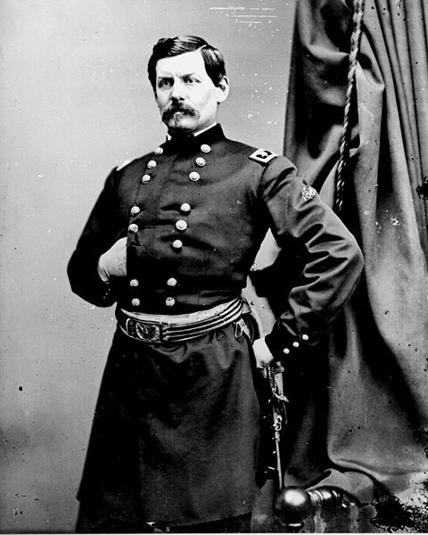
1861
McDowell
McClellan
Union General Irwin McDowell is demoted;
new Union general is George McClellan

Slide 24
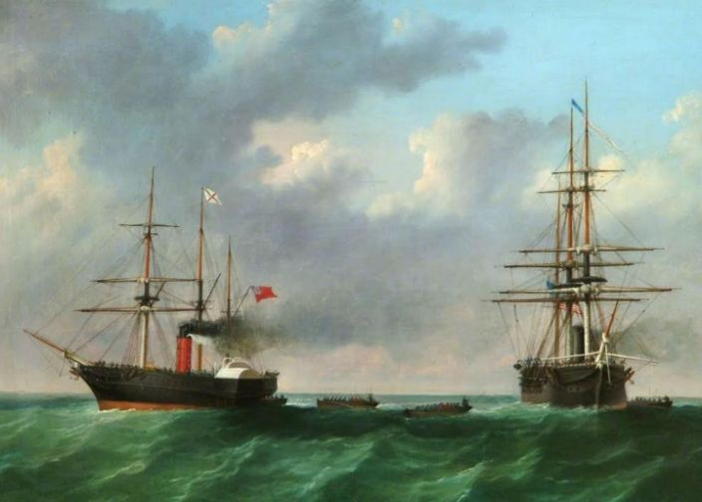
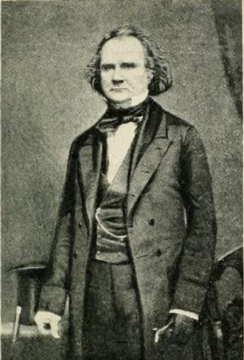
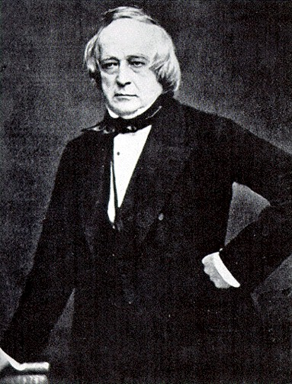
The Trent Affair
A British ship carrying two Confederate diplomats is stopped by a US Navy ship, and the diplomats taken prisoner.
Britain threatens war and economic sanctions, and Lincoln orders the men freed.

Slide 25
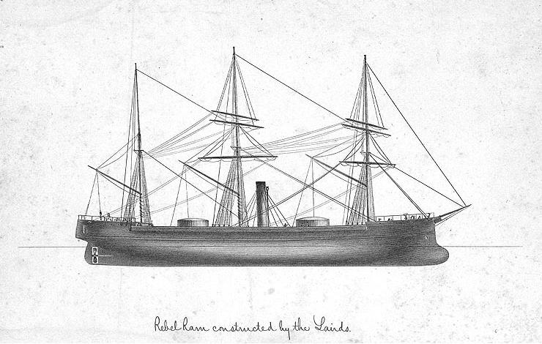
Laird Rams
-Ships built in England on behalf of the Confederacy
-Would have been extraordinarily powerful
-Seized by the British government before the Confederates could use them

Slide 26
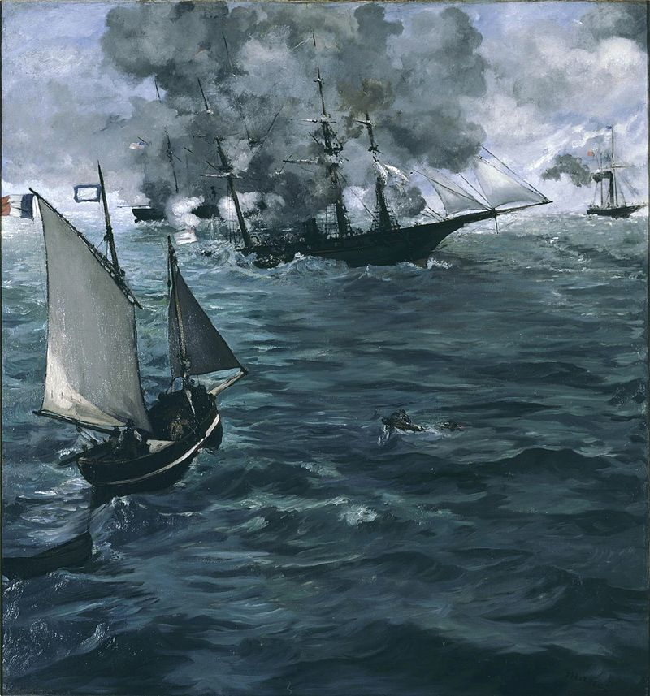
CSS Alabama
Commerce raider used by the Confederate Navy
Built by the Lairds in Great Britain
Captured 60+ Northern ships
Sunk by the USS Kearsarge off the coast of France
Post War Alabama Claims: US demanded the UK pay damages for commerce raiding. Britain paid $15 million in damages.

Slide 28
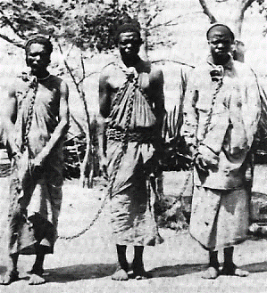
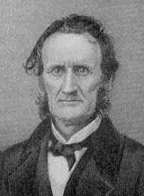
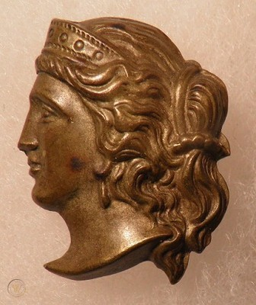
Lincoln’s Legal Issues
Suspension of Habeas Corpus: Lincoln suspended habeas corpus in several American cities and notably in Maryland. These actions were later confirmed by Congress.
Confiscation Acts: A series of laws allowing for the seizing and freeing of slaves owned by rebel Southerners.
Ex parte Milligan: US Supreme Court rules that northern civilians, usually who were against the war, can not be tried by military tribunals.
Copperheads: Anti-War, sometimes pro-Southern, Northerners. Most notorious: Clement Vallandigham

Slide 29
1862
Northern Plan:
In the East: Capture Richmond!
In the West: Control the Mississippi River

Slide 30
1862
Battle of USS Monitor vs. CSS Virginia – the first iron ships

Slide 31
I lost near Manassas
I lost near Richmond
Summer: Union loses battles near Richmond and Manassas, VA

Slide 32
Spring: Union captures New Orleans and wins at Shiloh, TN

Slide 33
Fall: General Lee invades Maryland, loses at Antietam – the bloodiest day in US history

Slide 34
1862
The East:
-Union invades eastern Virginia three times (The Peninsula, 2nd Manassas, Fredericksburg), loses each time
-First battle of iron ships in history (Monitor vs Virginia)
-Union wins at Antietam, Maryland
The West:
-Union Navy captures New Orleans, Louisiana
-Union General Ulysses S. Grant defeats Confederates at Shiloh, Tennessee

Slide 41
Also 1862: Union defeated at Fredericksburg, VA

Slide 42
1863
January 1: President Lincoln issues the Emancipation Proclamation, “freeing” the slaves

Slide 44
Financing the War
North: Mostly borrowing, but also: A federal income tax (3% on incomes over $800), a high tariff (the Morrill Tariff of 1861), the first Federal banking system since Jackson, and various excise taxes.
South: Attempting to sell cotton overseas in exchange for military supplies, and a complicated income tax.
Greenbacks: Union issued paper money, not redeemable for gold
Confederate currency: Also not backed by gold

Slide 45
We need more soldiers! (They keep dying off…)
North: Called for volunteers at first, later with signing bonuses, and instituted a draft in 1863: All males between 20-45 could be drafted. One could avoid the draft by paying a substitute to take your place, or pay $300 to the government.
Enormously unpopular with poorer people and immigrants, leading to draft riots in 1863.
South: Called for volunteers first, but instituted a draft in 1862: Obligatory military service for 3 years for all males 18-35(later 17-50), with some exceptions.
Notable exception: The “20 Negro Law.”
In the last months of the war, slaves were “recruited.”
Soldiers had enlisted for twelve months only, and had faithfully complied with their volunteer obligations; the terms for which they had enlisted had expired, and they naturally looked upon it that they had a right to go home. They had done their duty faithfully and well. They wanted to see their families. War had become a reality; they were tired of it. A law had been passed by the Confederate States Congress called the conscript act…He was conscripted. From this time on till the end of the war, a soldier was simply a machine, a conscript. It was mighty rough on rebels. We cursed the war, we cursed Bragg, we cursed the Southern Confederacy. All our pride and valor had gone, and we were sick of war and the Southern Confederacy. -Sam Watkins, 1st Tennessee Infantry

Slide 46
US Colored Troops
Recruitment began following the Emancipation Proclamation in 1863
The first regiment recruited was the 54th Massachusetts
175 regiments were recruited, including those made up of liberated former slaves in Southern states
Were paid less than white troops until 1864
Were more likely to be killed in battle, and few were ever captured.
16 black soldiers earned the Medal of Honor.
“Once let the black man get upon his person the brass letter, U.S., let him get an eagle on his button, and a musket on his shoulder and bullets in his pocket, there is no power on earth that can deny that he has earned the right to citizenship.”
-Frederick Douglass

Slide 48
Pacific Railway Act (1862): Provided Federal money and land subsidies to encourage the building of a transcontinental railroad to California. This would not be completed until 1869.
Morrill Land Grant Act (1862): Provided land grants to states to finance the establishment of colleges specializing in agriculture and mechanical arts.
Homestead Act (1862): Provided 160 free acres to any non-rebelling head of household (or intended citizen) so long as they improved it and lived there five years.

Slide 49
1863
Northern Plan:
In the East: Capture Richmond!
In the West: Control the Mississippi River

Slide 50
1863
The East:
-After a failed Union invasion of Virginia (Chancellorsville), General Lee invades the North and is defeated at Gettysburg, PA
The West:
-Union victory at Vicksburg, Mississippi
-Union captures Chattanooga, Tennessee
Vicksburg and Gettysburg are the major turning points of the Civil War.

Slide 51
Spring: Union defeated at Chancellorsville, VA. Conf. General Stonewall Jackson dies.

Slide 52
Summer: MAJOR Union victories at Gettysburg, PA (largest battle in American History) and Vicksburg, MS – the turning points of the war

Slide 53
Vicksburg

Slide 54
N

Slide 55
20th Maine at Little Round Top - Gettysburg

Slide 56
Pickett’s Charge - Gettysburg

Slide 57
Fall: Union Gen. Grant captures Chattanooga, TN

Slide 58
1863
November: Lincoln delivers the Gettysburg Address

Slide 60
Four score and seven years ago our fathers brought forth on this continent, a new nation, conceived in Liberty, and dedicated to the proposition that all men are created equal.

Slide 61
Now we are engaged in a great civil war, testing whether that nation, or any nation so conceived and so dedicated, can long endure. We are met on a great battle-field of that war. We have come to dedicate a portion of that field, as a final resting place for those who here gave their lives that that nation might live. It is altogether fitting and proper that we should do this.

Slide 62
But, in a larger sense, we can not dedicate -- we can not consecrate -- we can not hallow -- this ground. The brave men, living and dead, who struggled here, have consecrated it, far above our poor power to add or detract.
The world will little note, nor long remember what we say here, but it can never forget what they did here.

Slide 63
It is for us the living, rather, to be dedicated here to the unfinished work which they who fought here have thus far so nobly advanced. It is rather for us to be here dedicated to the great task remaining before us -- that from these honored dead we take increased devotion to that cause for which they gave the last full measure of devotion…

Slide 64
…that we here highly resolve that these dead shall not have died in vain -- that this nation, under God, shall have a new birth of freedom -- and that government of the people, by the people, for the people, shall not perish from the earth.

Slide 65
1864
Northern Plan:
In the East: Capture Richmond!
In the West: Control the Interior

Slide 66
U.S. Grant promoted to Lt. General in command of all Union armies, and he turns his attention to Lee in Virginia

Slide 67
1864
The East:
Union General Grant invades Virginia
-The West:
-Union captures and burns Atlanta, Georgia
-Battle of Mobile Bay, Alabama
-Union General William Sherman marches across Georgia, destroying everything he finds.

Slide 68
1864
Washington DC
Wilderness
Spotsylvania
Cold Harbor
Richmond
Petersburg

Slide 69
1864

Slide 70
“Damn the torpedoes, full steam ahead!”
-Union Admiral David Farragut, Battle of Mobile Bay

Slide 71
August: General William T. Sherman invades Georgia, captures Atlanta, and begins his “March to the Sea.”

Slide 72
Atlanta
Savannah

Slide 74
Election of 1864
“National Union”
(Republican): 212
President: Abraham Lincoln
Vice President: Andrew Johnson
Democrat: 21
President: George McClellan

Slide 75
With malice towards none, with charity for all, with firmness in the right as God gives us to see the right, let us strike on to finish the work we are in; to bind up the nation’s wounds; to care for him who shall have borne the battle, and for his widow and his orphan; to do all which may achieve and cherish a just and lasting peace among ourselves and with all nations.

Slide 76
1865
Northern Plan:
In the East: Capture Richmond!

Slide 77
1865
The East:
-Union army finally captures Richmond, VA
-Confederates surrender at Appomattox Courthouse, Virginia.

Slide 79
April: Petersburg surrenders, allowing the Union to capture Richmond
Washington DC
Richmond
Petersburg

Slide 83
1865
April 14: Abraham Lincoln assassinated by John Wilkes Booth at Ford’s Theater

Slide 84
1865
April 14: Abraham Lincoln assassinated by John Wilkes Booth at Ford’s Theater

Slide 85
1865
April 15: Abraham Lincoln dies

Slide 86
1865

Slide 87
1865
April 26: John Wilkes Booth killed

Slide 91
Total Casualties:
Union:
140,414 Killed in action
365,000 Total war dead
275,200 Wounded
Confederacy:
72,524 Killed in action
260,000 Total War dead
137,000 Wounded
TOTAL DEAD:
625,000 Dead
412,200 Wounded
1,037,200 Total Casualties

Slide 92
The Civil War in Cheshire County

Slide 93
Alstead
Adams, Albur: wounds
Ball, Levi: Roanoke, NC
Banks, Prentice: disease
Caldwell, Shepard: Falmouth, VA
Conway, Joseph: disease
French,Henry: disease
Haynes, Henry: Winchester, VA
Hodgkins, Daniel: Williamsburg
Kern, John: Cold Harbor
Keyes, Hiram: Andersonville
Pierce, Samuel: disease
Rancey, Charles: Fredericksburg
Shedd, Herman: Oak Grove
Shepard, Harvey: disease
Wetherbee, Charles: Fair Oaks
Wilder, Charles: disease
Wilder, Henry: disease
Willard, Parkman: disease

Slide 94
Chesterfield
Colburn, Warren: Andersonville
Hubbard, Henry: Disease
Martin, James: Disease
McClenning, Henry: Disease
Streeter, Albert: Disease
Streeter, Herbert: Disease
Streeter, Marshall: Wounds

Slide 95
Dublin
Abbott, Sylvester: Hatteras Inlet, NC
Beal, William: 2nd Manassas
Cogswell, Rufus: Wounds
Derby, Nathan: Disease
Fisk, Jesse: Winchester, VA
Greenwood, Albert :Winchester, VA
Hazen, Edson: Disease
Hazen, George :Winchester, VA
Heald, William: Disease
Holt, Henry: Disease
Holt, Samuel: Cedar Creek
Kendall, John: Drowned
Learned, Lewis: Cedar Creek
Lyle, Alexander : Williamsburg,VA
Monks, John: 2nd Manassas
Phelps, Charles: 2nd Manassas
Phillips, John: Ofuts Junction, MD
Pierce, Almon: Disease
Pierce, Asaph: Disease
Richardson, Malachi: Cold Harbor
Sawtell, Solomon: Disease
Towne, Edgar: Fredericksburg
Warren, George: Disease
Willard, Levi: 2nd Manassas

Slide 96
Fitzwilliam
Lillie, Levi: Disease
McManus, John: ?
Miles, George: Fair Oaks
Morris, Patrick: ?
Morse, Elihu: Nicolasville, KY Nixon, Richard: At sea
Parker, Charles: Butte La Rose LA Rice, Levi: ?
Richardson, Thomas: At sea Stone, Albert : of wounds
Stone, Joseph: Brashear City, LA Stone, William: ?
Taft, Josiah: Disease
Walton, Robert: Disease Whitney, Francis: ?
Wilson, George: Wilderness Withington, Albert: ?
Adams, John :Disease
Brooks, Daniel: Prisoner
Brooks, Walter: ?
Church, John :Nicolasville, KY Deeth, Martin: Petersburg
Ellis, Elliot: Disease
Felch, George: Winchester, VA Fisher, Orvis: ?
Forristall, Jonas: Disease
Forristall, Levi: Disease
Handy, Ransom: ?
Harkness, Elisha: Brashear City, LA Heywood, Charles: Port Hudson LA Holman, Thomas: ?
Lawrence, Fred :?

Slide 97
Gilsum
Bignall, Thomas : Gettysburg
Davis, James: POW
Harris, Charles: Chancellorsville Howard, Sherman :2nd Manassas Howe, Asa: Fort Gilmer
Nash, Orsamus: Disease
Wilcox, Henry: Disease

Slide 98
Hinsdale
Armstrong, Alpheus: Disease
Butler, Charles: Gettysburg
Butler, Slate: ?
Butt, Francis: Cold Harbor
Carruth, Thomas: Carrollton, LA Chamberlain, Ira: Hilton Head Cooper, Abraham :Gettysburg Crowningshield, Arnold :Disease Crowningshield, Daniel: Salisbury
Doolittle, Charles: Charlestown, VA Herrick, James: ?
Hill, Elisha: Wounds
Howard, James: Port Hudson Peeler, Charles: Cedar Creek
Polley, Gilbert: Disease
Russell, Haskell: Disease
Smith, Thomas: Wounds Thomas, Frederick: Winchester Webber, Jacob: Disease
Welch, William: Gettysburg Wyman, Nathaniel: Winchester

Slide 99
Jaffrey
Bailey, Almon: Disease
Bailey, Harvey: Disease
Bennett, Hiram: Disease
Caldwell, John: Disease
Capron, John: unknown
Carter, Charles : Cedar Creek
Carter, Oscar: Disease
Colburn, Daniel :Disease
Cummings, John: Disease
Darling, John: Disease
Emery, Charles: Disease
Fassett, Luther: Disease
Graves, Ezra: Antietam
Lacy, Joseph: Wounds
Newell, Jacon: Disease
Rand, Leonard: Disease
Ritchie, Edmund: Disease
Rolf, John: unknown
Sawtell, Jonas: Disease
Stratton, Julius: Disease
Tehen, Morris: Hanged by South
Waters, Sylvanus : Antietam Wetherbee, Frank: Antietam Wheeler, Edwin: unknown

Slide 100
Keene
Ellis, Warren: Died of wounds Evans, Frank: Disease
Flint, Henry: Disease
Flynn, Martin: Petersburg Hodgkins, William: Disease Holton, Henry: Disease
Howard, William: Disease
Jenks, Henry: Cedar Creek
Jones, Sylvester: Disease
Keith, Fay: Disease
Lamson, John: New Bern
Lane, Nathaniel: Williamsburg Lang, William
Leverett, Frank: Disease
Marsh, George: Drowned Marvin, Edwin: Disease McCaffrey, Patrick: Spotsylvania Metcalf, Henry: Gettysburg
Bailey, Augustus: Disease
Bromley, Joshua: Cold Harbor Brown, John: Disease
Califf, William: Wounded
Chase, Charles: Disease
Cheney, Clinton: Disease
Cleary, Cornelius : Gettysburg Crossfield, Benjamin :Petersburg Davis, James: Disease
Davis, Oliver: Drewry's Bluff Demore, Anthony: Fredericksburg Douglass, Samuel: 2nd Manassas Drummer, John: Disease
Drummer, William: Gettysburg Dunn, Noble: Disease

Slide 101
Keene, continued
Morris, Edward: Petersburg Muchmore, George: 2nd Manassas Parker, Warren: Gettysburg
Parker, William: Disease
Perham, Edmond :Disease
Reed, John: Fair Oaks
Roby, Charles: Disease
Ruffle, Samuel: Disease
Salter, Antoine: Disease
Sprague, Henry: Disease
Spring, William: Gettysburg
Stearns, Charles: Disease Sturtevant, Edward: Fredericksburg Towne, Elbridge: Cold Harbor Towns, Charles: Disease
Turner, Gardner: 2nd Manassas Wait, John: Fredericksburg White, Henry: Disease
Willard, W. Henry: Disease Wyman, Emery: Drewry's Bluff

Slide 102
Marlborough
Gates, Everett: Nicolasville, KY Knowlton, Charles: Poolsville, MD Lewis, Horace: Cold Harbor
Mason, Charles :Wounds
Pike, Charles: 2nd Mansassas
Rust, Nathanial :Winchester, VA Stockwell, George: wounds
Totten, John: Gettysburg
White, Rhodolphus: Disease

Slide 103
Marlow
Dunham, William: Disease
Fox, Orrin: ?
Heaton, Albert: Williamsburg
Infant, James: Farmville, VA
Miner, Ezra: Fair Oaks
Tinker, Milan: Disease
Tyler, William: Disease
Whittemore, George: Disease

Slide 104
Nelson
Atwood, Milan: ?
Atwood, Rufus: Disease
Bancroft, Washington: Disease Hardy, George: Disease
Kenerson, Sylvanus: Disease
Knight, Harlan: Fredericksburg Osborn, Cortiss: Disease
Osgood, Abner: Disease
Parker, Lucius: Winchester
Phillips, Joseph: Wounds , CSA Phillips, Judson: Wounds, CSA Phillips, Minot: Disease
Smith, Nathaniel: Disease
Stevens, John: 2nd Manassas
Taft, Edward: Williamsburg
White, Gilman: ?
Worth, Charles: Gettysburg

Slide 105
Richmond
Allen, Moses: Winchester
Ballou, Alden: Disease
Barrus, Benjamin: wounds
Barrus, George: wounds
Barrus, Otis: Winchester
Bolles, Henry: accidental
Bolles, John: Libby Prison
Buffum, Esek: Disease
Cass, Jarvis: Disease
Colburn, Artemas: Winchester Harris, Caleb ?
Jillson, Almon: Laurel Hill
Jillson, Silas: Disease
Martin, Stephen: New Bern
Newell, Benjamin: Disease
Palmer, Dexter: Disease
Putney, Nahum: Algiers, LA
Scott, Walter: Winchester
Starkey, John: 2nd Manassas

Slide 106
Rindge
Allen, Daniel: Disease
Bradish, George: ?
Clapp, Cyrus: 2nd Manassas Hastings, John: 2nd Manassas Kemp, William: Disease
Kimball, George: Disease
Norcross, Dr. George: Disease Reynolds, John: 2nd Manassas
Rice, Elmer: Camp Stoneman Shaffee, Joseph: Petersburg
Smith, Charles: ?
Smith, Darwin: Disease
Smith, Henry: Poolsville, MD
Smith, Walter: Lost at Sea Smith,Nathan: Salisbury, NC Stearns, George: Disease
Stratton, Edward :Disease Withington, William: Disease

Slide 107
Roxbury
Lawrence, Alanson: disease
Lewis, John: Fredericksburg Thatcher, Charles: Gettysburg Wheeler, Albert: Wounds
Wyman, Thomas: disease

Slide 108
Stoddard
Durand, Joel: Wounds
Fox, George: Antietam
Greene, Reuben: ?
Heath, Justus: ?
Hoffman, Peter: Disease
Messinger, Addison: Cold Harbor Reed, Charles: Disease
Stevens, Anthony: Fredericksburg Stevens, Henry: Disease
Tyler, John: 2nd Manassas
Weber, Conrad: Disease
Wilson, Asa: Pt. Lookout, MD Wood, Carlos: Wounds
Wood, Samuel: Fort Wagner

Slide 109
Sullivan
Black, Silas: Disease
Breed, German: Disease
Frost, Edwin: Cold Harbor
Holt, Russell: Disease
MacDonald, Patrick: 2nd Manassas Nims, Edwin: Disease
Rugg, Andrew: Disease
Rugg, Gardner: Disease
Spaulding, Dauphin: Disease Spaulding, Henry: Disease Spaulding, Orland: Disease
Wilson, Braman: Disease
Wilson, Charles: Winchester

Slide 110
Surry
Bissell, Albert: Petersburg
Black, Summer: Harper's Ferry Britton, Charles: Alexandria, VA Howard, John: Disease
Peabody, Chauncy: Disease
Stone, Rufus: Disease
Woodward, John: Disease

Slide 111
Swanzey
Applin,Henry: Petersburg
Belding, George: California
Bennett, Fernando: Port Hudson Bowles, Sanford: Brashear City Buffum, David: Disease
Burns, Thomas: 2nd Manassas Comings, David: Disease
Cross, Ebenezer: Andersonville Darling,Lowell: 2nd Manassas Dickinson, Aaron: KIA
Dickinson, Wallace: Cairo, IL Doolittle, Edward: Poolsville, MD Hamblet, Atwell: ?
Harvey, Thomas: City Point, VA Healey, Daniel: Fort Fisher
Hewes, Orion KIA
Jackson, Truman: Andersonville Lampson, Bradford: Savannah Lawrence, Rodney: KIA
Lombard, George :North Carolina Lyman, William: KIA
Nitchker, Frederick: Wounds Plummer, Jerry: Disease
Quinn, Charles: Antietam
Smith, Newell: KIA
Stone, Demeret: New Orleans Stone, John: Gettysburg Thatcher, Willard: Disease Thompson, Harvey: City Point, VA Town, Charles: Petersburg

Slide 112
Swanzey, continued
Trowbridge, George: Drewry's Bluff Welch, George: City Point, VA Whitcomb, Lyman: 2nd Manassas Whitcomb, Lucius: 2nd Manassas Wilber, Sanford: New Orleans Williams, Sexton: Wounds
Wright, Elliott: Disease

Slide 113
Troy
Amadon, John: disease
Burde, Ernest: Poplar Spring Church Clark, George:?
Clement, Lucius: disease
Collins, John: Spotsylvania
Derby, George: Drowned
Douglass, John: disease
Fisk, Daniel: Antietam
Lawrence, Alfred: Andersonville Lawrence, Frederick : unknown
Piper, Francis: disease
Spooner, Lyman: Savannah
Stickney, Silas: wounds
Sargent, Charles: unknown

Slide 114
Walpole
Barker, William: Disease
Barnet, Wesley: Disease
Bragg, Willard: Disease
Fay, Warren: Disease
Gates, Benjamin: Disease
Hooper, Henry: ?
Hooper, Lewis: Spotsylvania Kraetzer, Otis: wounds
Lawrence, Benjamin: wounds Lawrence, Leonard :?
Livingston, Edward: Disease
Perigo, George: Winchester
Slade, George: ?
Wetherby, George: Winchester

Slide 115
Westmoreland
Bennett, James: Disease
Burcham, William: Disease Chamberlain, Norton: New Orleans Clark, John: Disease
Douglass, Elisha: Spotsylvania Heustis, Aristides: Disease
Joslyn, Luther: Disease
Leach, Albert: Disease
Leach, Charles: Disease
Low, Leonard: Petersburg
Lucas, Phillip: Disease
Mason, Moses: Disease
Metcalf, Amos: White Oak Swamp Starkey, William: ?
Winchester, Sydney: ?
Young, Sidney: Winchester

Slide 116
Winchester
Ball, Charles: Winchester
Barratt, Henry: New Bern, NC Blanchard, Isaac: Fair Oaks
Browns, Frank: Hall's Hill, VA Chamberlain, Francis: Williamsburg Davis, Nathaniel: Wounds
Eaton, James: ?
Fosgate, William: Winchester Garfield, Lauren: Winchester Hammond, Lorenzo: Disease Hannifen, Gregory: Chancellorsville Holden, Amos: POW
Houlighan, James: Disease
Kidder, John: Disease
Lawrence, Rodney: Fair Oaks
Lewis, Freeman: Secessionville SC Madison, Timothy: Disease Morrill, Frank: Disease
Murphy, John: Disease
Norwood, George: Drowned Olsen, Peter: Disease
Pratt, Eugene: Cold Harbor
Rich, Rienzi: Petersburg
Ripley, Theodore: hanged by KKK
Scott, Lucius: Disease
Swan, Denzel: Disease
Thayer, Eli: Disease
Thayer, Henry: Disease Whittemore, Jotham: ?
Woodard, Joseph: Cold Harbor

